Slide 1
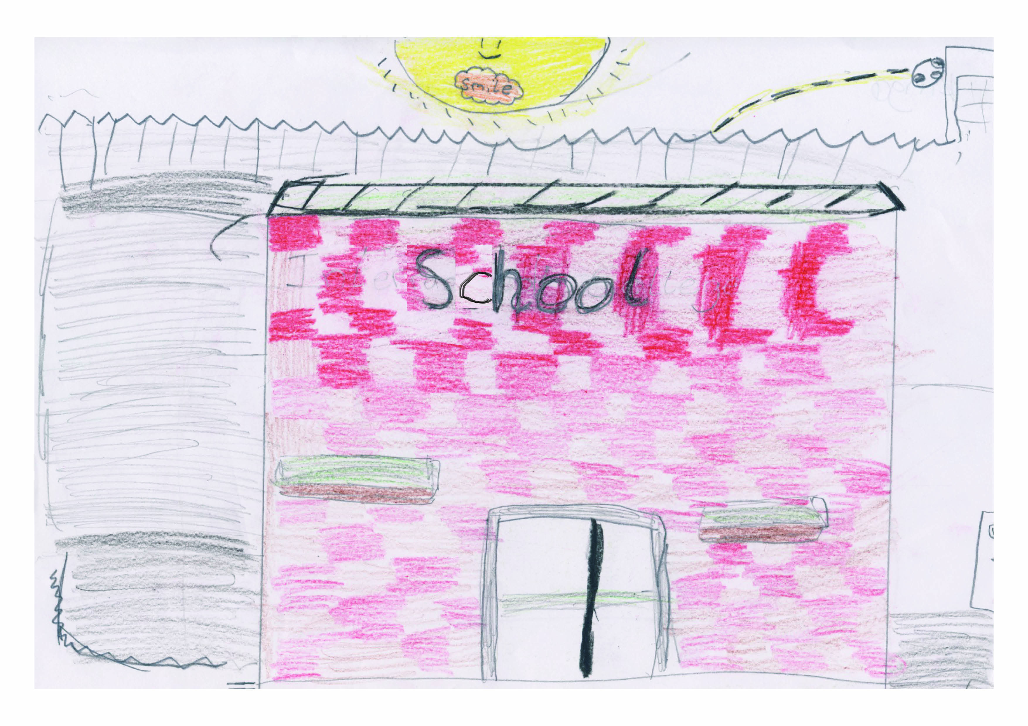
Transition Programme
Moving from Primary 7 to Year 8
Notes:
Today we will be talking to you about what it is like moving from Primary 7 to Year 8.

Slide 2
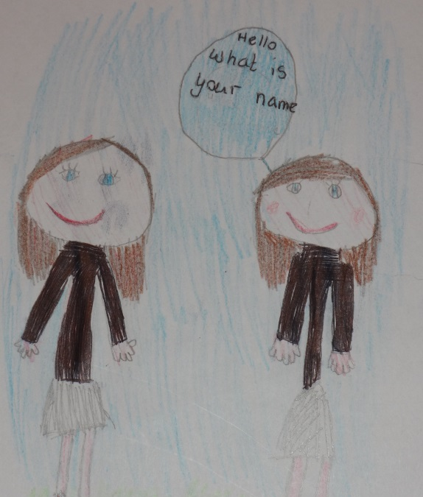
Main Areas of Concern
Making Friends
Getting Lost
Being Organised
Bullying
Attendance
General Concerns
Notes:
As we move through the presentation we will be looking at the main areas of concern that year 8 pupils have identified from their own experience of transition in September.
The main areas of concern are:
Making friends
Getting lost
Being organised
Bullying
Attendance
General Concerns

Slide 3
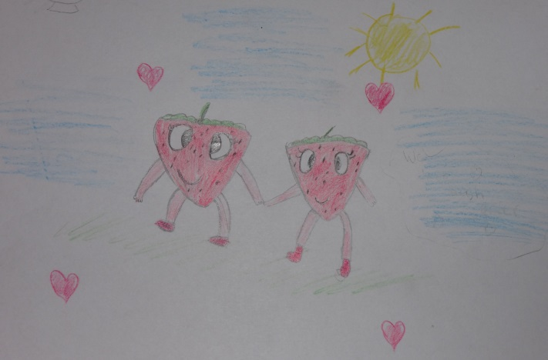
Making Friends
Introduce yourself
Talk to other students at break/lunch time
Take part in activities/go to clubs
Don’t be shy
Notes:
Making friends can be something we all find hard at times, but let me assure you starting a new school is one of the best ways to make new friends.
Take time to introduce yourself – go up to someone and say hello and ask them what their name is. Don’t be afraid to tell them a few facts about yourself and ask them questions about themselves.
Always talk to other pupils at break and lunch time – go and sit down at lunch beside other pupils and start a conversation with them. Make the effort to talk during break and lunch because when you are in class all day, it can be quiet … because you are working so hard you don’t have time to talk.
I would advise you to take part in some extra-curricular activities as this is a fantastic way to make new friends, that are not in your form class/year group.
Don’t be shy … I am sure you are thinking “that’s easy for you to say” but if you want to be able to talk to people and create conversations with your friends you will need to overcome your shyness. Remember you want people to be able to see how confident you are.

Slide 4
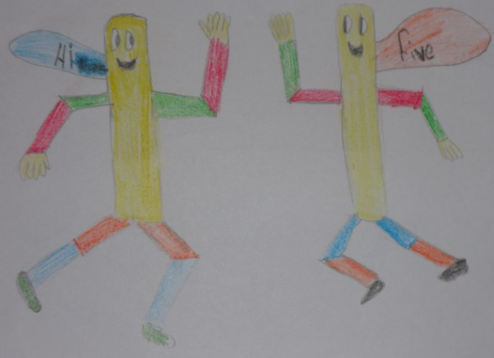
Making Friends
Be helpful
Talk to people with similar interests
Make new friends in team activities
Talk to people on your bus
Take part in the summer scheme
Notes:
Always try to be helpful towards others – it doesn’t take much to smile, to say hello or to answer a question for someone. We can all be helpful in our own way, big or small.
Even though you are all unique individuals some people may share the same interests as you, for example, you may all like the same type of music or the same football team or the same novels. This is often a good way of starting a conversation and building friendships.
In school there are lots of different team activities you can take part in, football, hockey and choir to name a few. Just like the extra-curricular activities mentioned earlier, team activities are a great way of making new friends - both inside and outside of school.

Slide 5
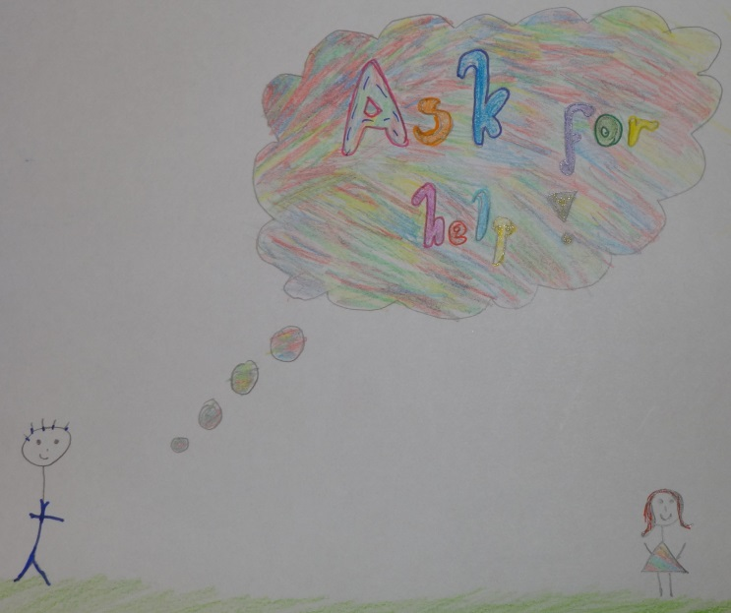
Getting Lost
Stay close to someone in your class
Stay calm – don’t panic
Go to the office
Ask for directions
Notes:
Another area which might cause some concern when moving school is that you might get lost.
Here is some advice from year 8 pupils
Always stay close to other pupils in your class – when you are moving from one classroom to another this is a great way of getting there, until you find your way about.
Try your best to remain calm – believe me when I say, if you get lost you will not be the first nor the last I am sure
Don’t be afraid to ask another pupil, in the corridor, where your class is. To do this you will need to make sure you have a copy of your timetable in your blazer or school bag so you know what the room is called. Some of the students have been in this school for nearly seven years so they will know their way around and be able to guide you
You can always ask some of the teachers if you get lost
Remember boys and girls everyone gets lost so don’t be shy and ask someone for help

Slide 6
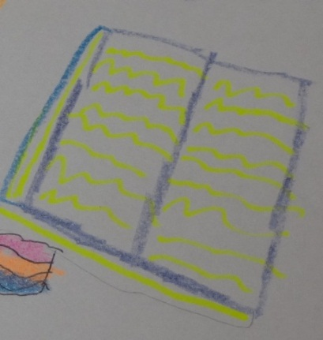
Being Organised
Sort out your bag the night before school
Always have your books
Always have the right equipment
Make sure your homework is completed/Do your homework on the day you get it
Notes:
Being organised is an area that some people are naturally good at while others need to take time to get it right. But as adults always tell us, practise makes perfect.
The first bit of advice I would give you is to carefully pack your school bag each night when you have finished your homework. Always have your timetable beside you so you can check what subjects you have the next day, making sure you have the right books for the right subjects. Try to avoid having to pack it in the morning as you can be rushing and forget some books.
Always have the right equipment. We are all alike, teachers and pupils, 1st September we all have full pencil cases; pens, pencils, ruler, rubber, sharpener, colouring pencils etc.; how long does it last? You will more than likely get a list of equipment that you are expected to have for your lessons, be organised and make sure the right equipment is in your school bag when you are packing your books, the night before school.
Make sure that all your homework is completed on the day that your teacher gives it to you, for example, if you have art on a Monday do your art homework that night instead of panicking to complete it on the night before it is due.

Slide 7
Bullying
Tell someone
Be friendly with everyone, so no one is left out
Walk away/Ignore the bully
Treat people how you would like to be treated
Notes:
The next two slides look at bullying – we are going to talk you through some points on what to do if you are being bullied or know someone who is being bullied.
Always tell someone; an adult, member of staff or a friend that you trust about the bullying. Asking teachers for help will help put a stop to the bullying and they will tell the bully’s parents.
Make sure you include everyone and that everyone in your circle of friends are happy and not lonely. If you notice someone on their own in playground at break or lunch time make a special effort to speak to them and include them in your activities.
Be the better person – if the bully comes up to you, walk away and don’t let him/her get the better of you – ignore them and walk away.
Always treat people how you would like to be treated – think before you speak – be nice to others and they will be nice to you.

Slide 8
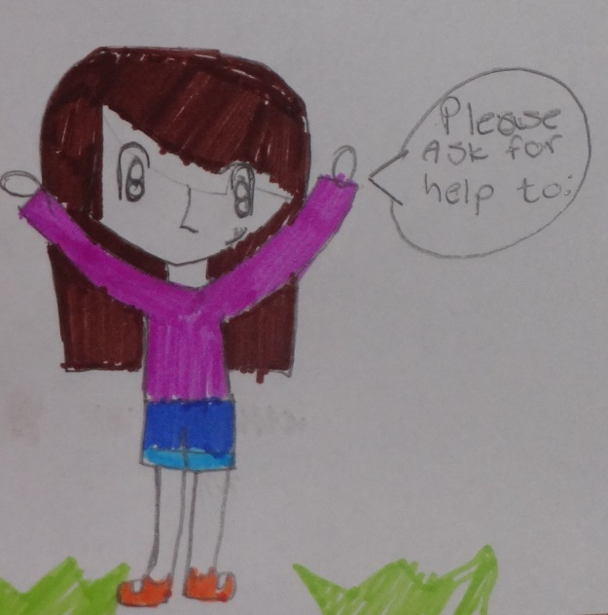
Bullying
Don’t make anyone feel bad about themselves
Don’t pretend to be someone you are not
Stand up for yourself
Notes:
Always be nice to other pupils around you – remember not to make anyone feel left out or feel bad. Also remember that you are all individual so just because other people might be making someone feel bad about themselves, doesn’t mean you have to join in too. Stand up for others who may be feeling left out or bad about themselves.
BE YOU! When you move to a new school just be yourself; people will accept and like you for who you are. It is important that you hold on to what makes you you and don’t pretend to be someone you are not.
Standing up for yourself does not mean that you take the bully on and fight with them, it means you seek help and let other people, for example teachers, help stop the bully.

Slide 9
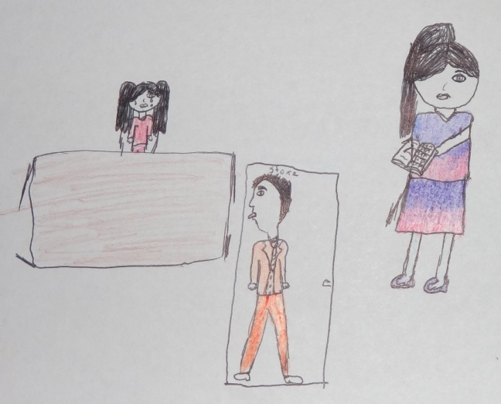
Attendance
There are many incentives for attending school
It helps build up your confidence
When you miss out on school you miss all the fun things that are happening
It is important so that you don’t
miss out on school work and
fall behind
Notes:
What is attendance?
Attendance is a log of how long you have attended school, for instance some schools say that you should be getting 95% or more for attendance and 85% or lower is unsatisfactory
85%
= 29 days absent
= Approximately 6 weeks
= 232 lessons
Being in school/work everyday is something you should all strive for. This in itself will help you feel more positive, which in turn will help boost your confidence. When you feel confident you will work harder and achieve great results.
You could miss out on something important like a test or you could fall behind in your work or miss an important announcement about a school trip or miss something fun.

Slide 10
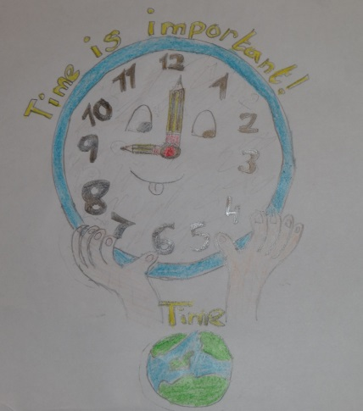
Attendance
A good education helps you do well in life for example in getting a good job
Employers often look at your attendance record before offering you a job
You may miss out on rewards offered by
your school
You miss being with friends
Notes:
I know you are only in Primary Seven but it is important to remember that a good education will help you do well in life, especially when you are at the stage of looking for a job. Some employers will ask your school for a reference, a written document about you as a pupil when you were at school. Your attendance will be included in this.
Also school is a great place to be with your friends, in a safe and secure environment. Some of your friends in school may not live in the same estate or area as you so if you don’t go to school you will miss out on being with your friends.

Slide 11
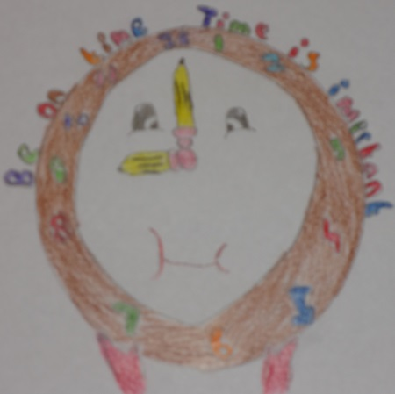
Attendance
Only be off school for a genuine reason, for example illness or bereavement
If you are off it is important to hand in absence notes to your form teacher
Be safe, always stay in school and only
leave if you have permission
Notes:
Just so you know, there are some circumstances where you may be off school such as if you are sick or there has been a bereavement in the family. The teachers in school are very understanding when this happens BUT it is important to catch up on the work missed once you return to school, and don’t be afraid because the teachers will help you with this.
Remember if you are absent from school that you bring in a note, on the day you return, and give it to your form teacher. This will tell him/her why you were off school and they can keep a record of this.
Your safety is so important when in school so always stay in school and only ever leave if you have permission, for example, if a parent/guardian comes to collect you for an appointment – and on that note appointments should always be made after school to avoid you missing out on your lessons.

Slide 12
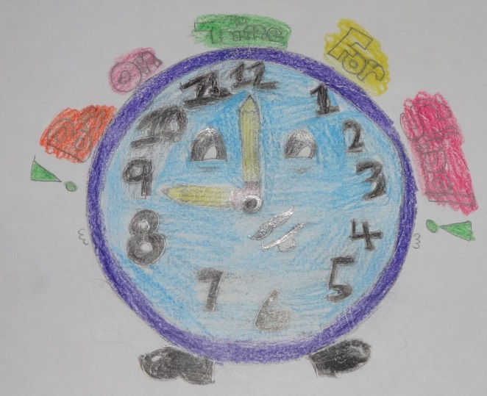
General Concerns
Keep belongings safe
Be on time
Older people will help you
Notes:
We are going to conclude our presentation by talking to you about general concerns that you might have about moving to a new school.
Do you care for your belongings? If you do you should try and make sure that you keep your belongings safe as best as you can. For example, if you have money, a bus pass or dinner pass make sure you keep them safe and secure in the zip pocket of your blazer.
One of the most important aspects of school is to be on time for school and for your classes because it is really important to be on time so you don’t miss out on important messages in registration or work in class. You will soon get into the habit of being on time for everything.
General concerns that some Primary 7 pupils have is that they are afraid of older students but older students will help you if you are lost; it might seem quite scary to go up to an older student but just go for it and they will help you.

Slide 13
