Slide 1
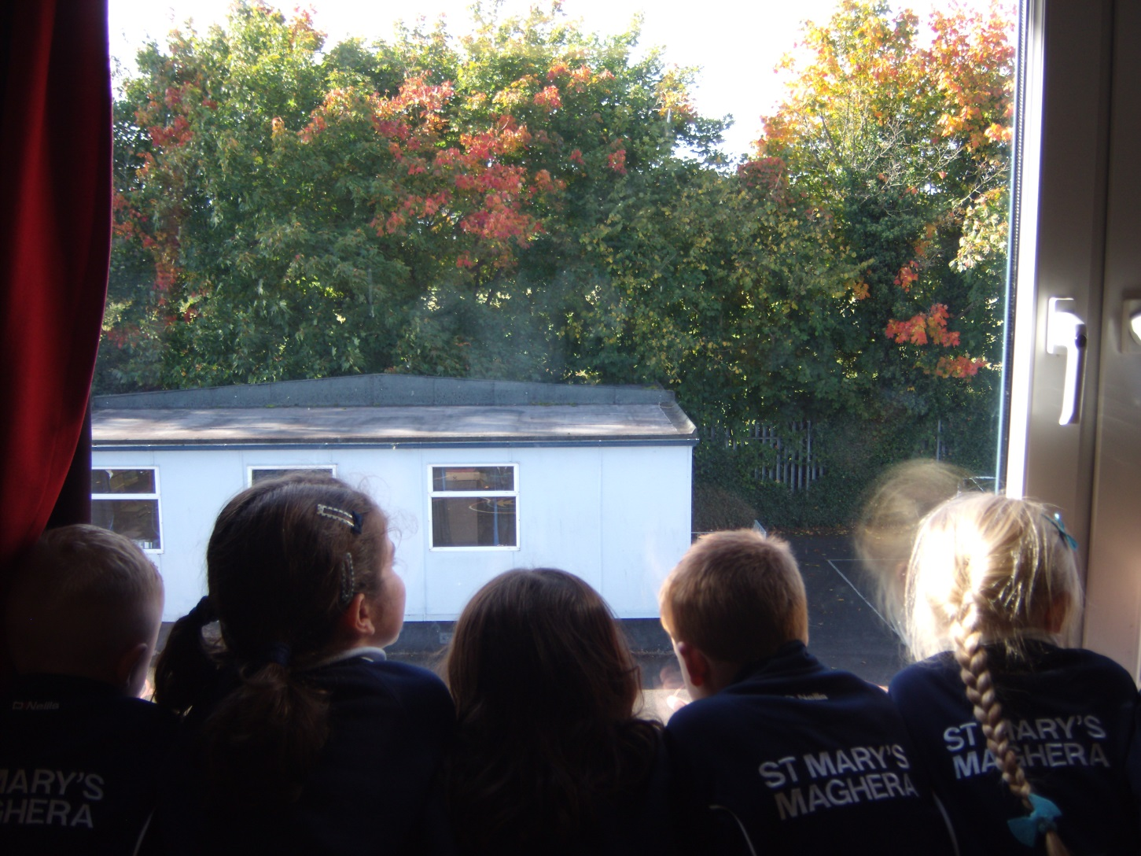
A room with an Autumn view.
Notes:
Looking out of an upstairs window at the beautiful Autumn leaves.

Slide 2
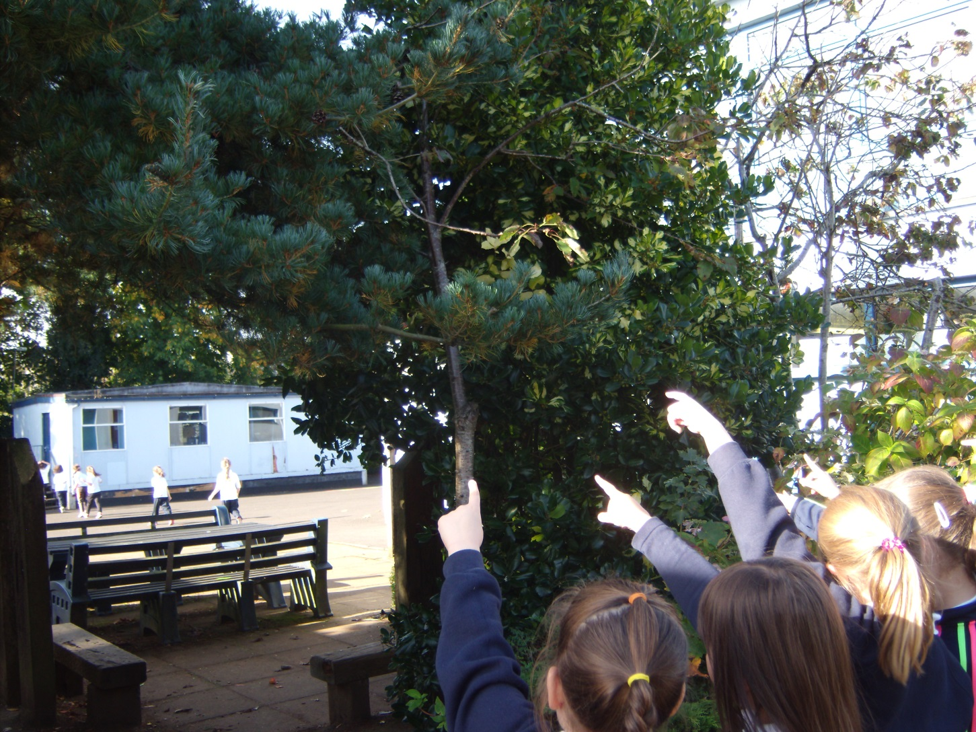
We were surprised to find acorns in our school garden.
Notes:
We were surprised to find acorns in our school garden.

Slide 3
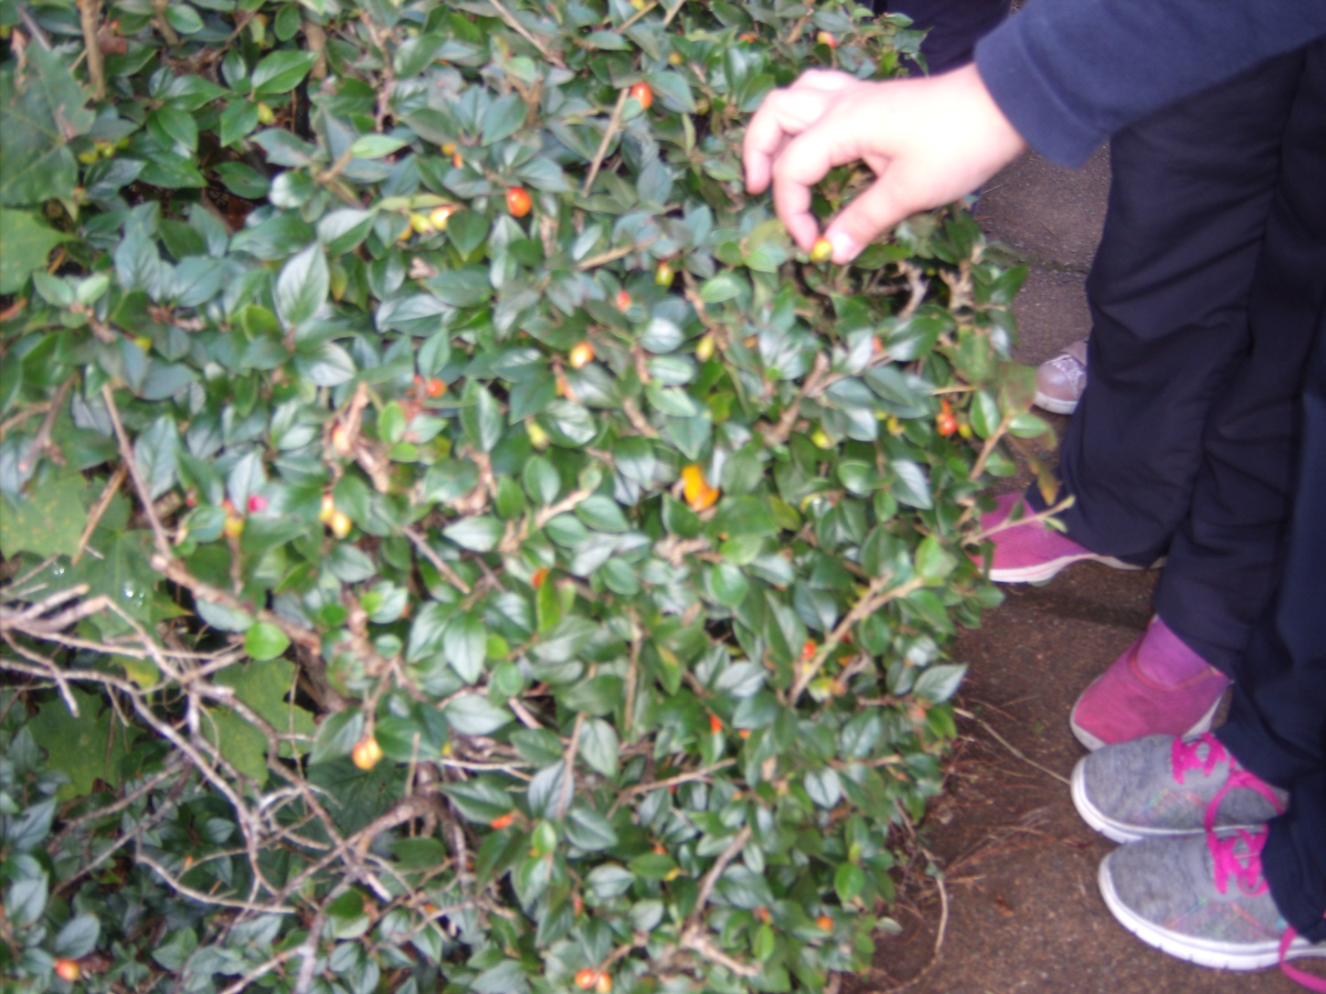
The berries are so tiny.
Notes:
So many red berries.

Slide 4
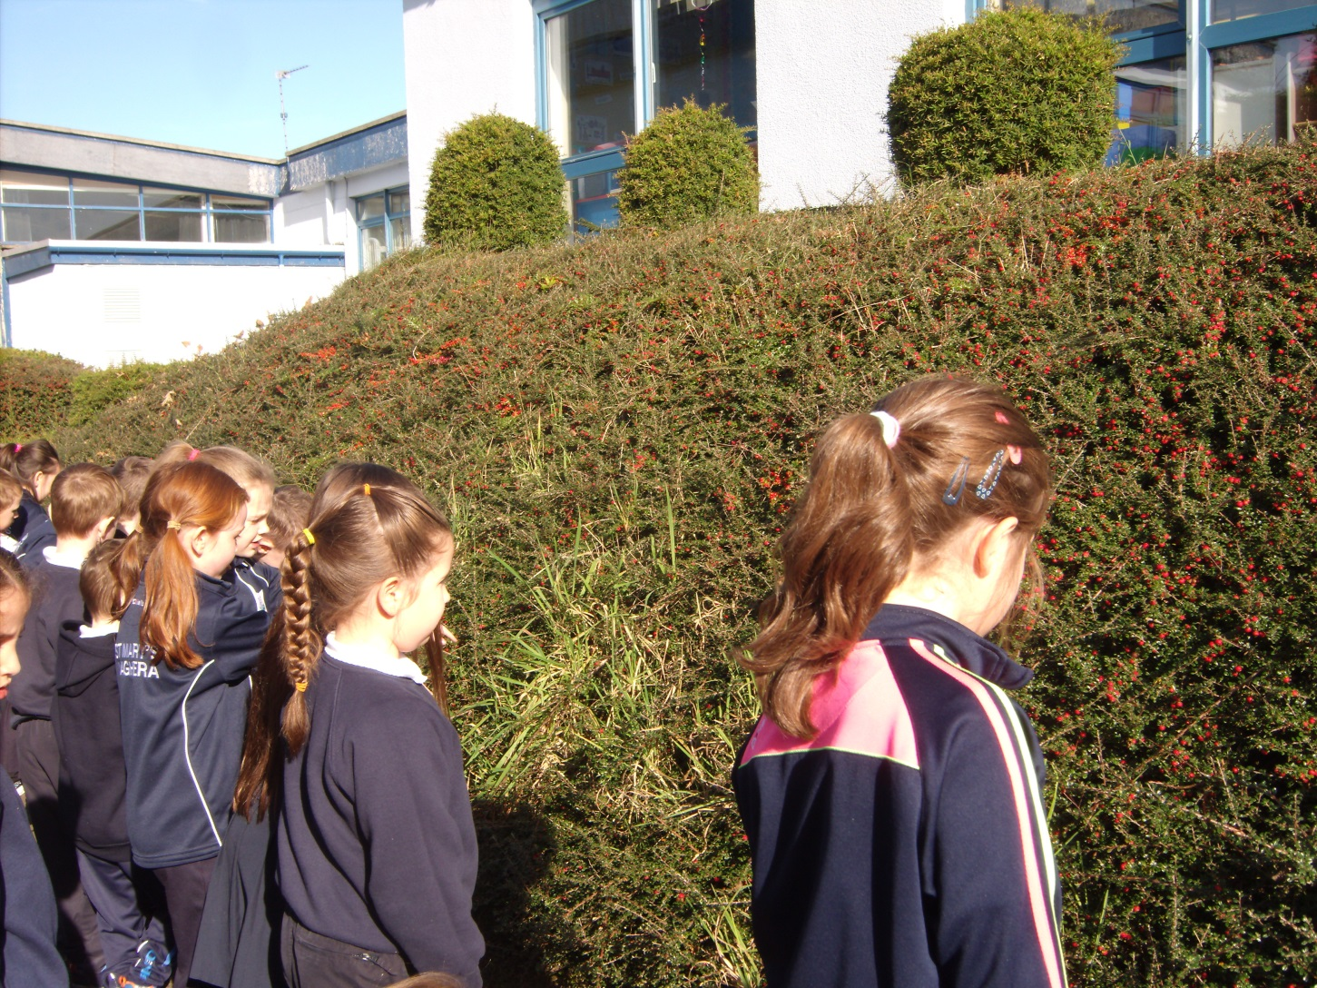
We looked at a multitude of tiny Autumn berries along our school path.
Notes:
Observing a multitude of Autumn berries along our school path.

Slide 5
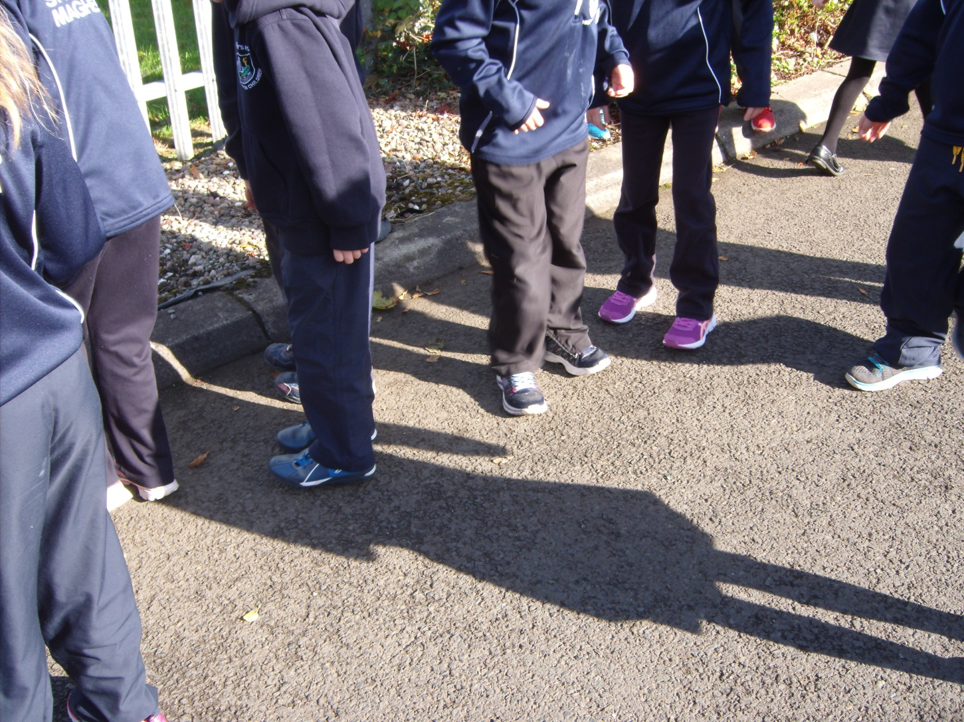
We played with our shadows.
Notes:
We played with our shadows.

Slide 6
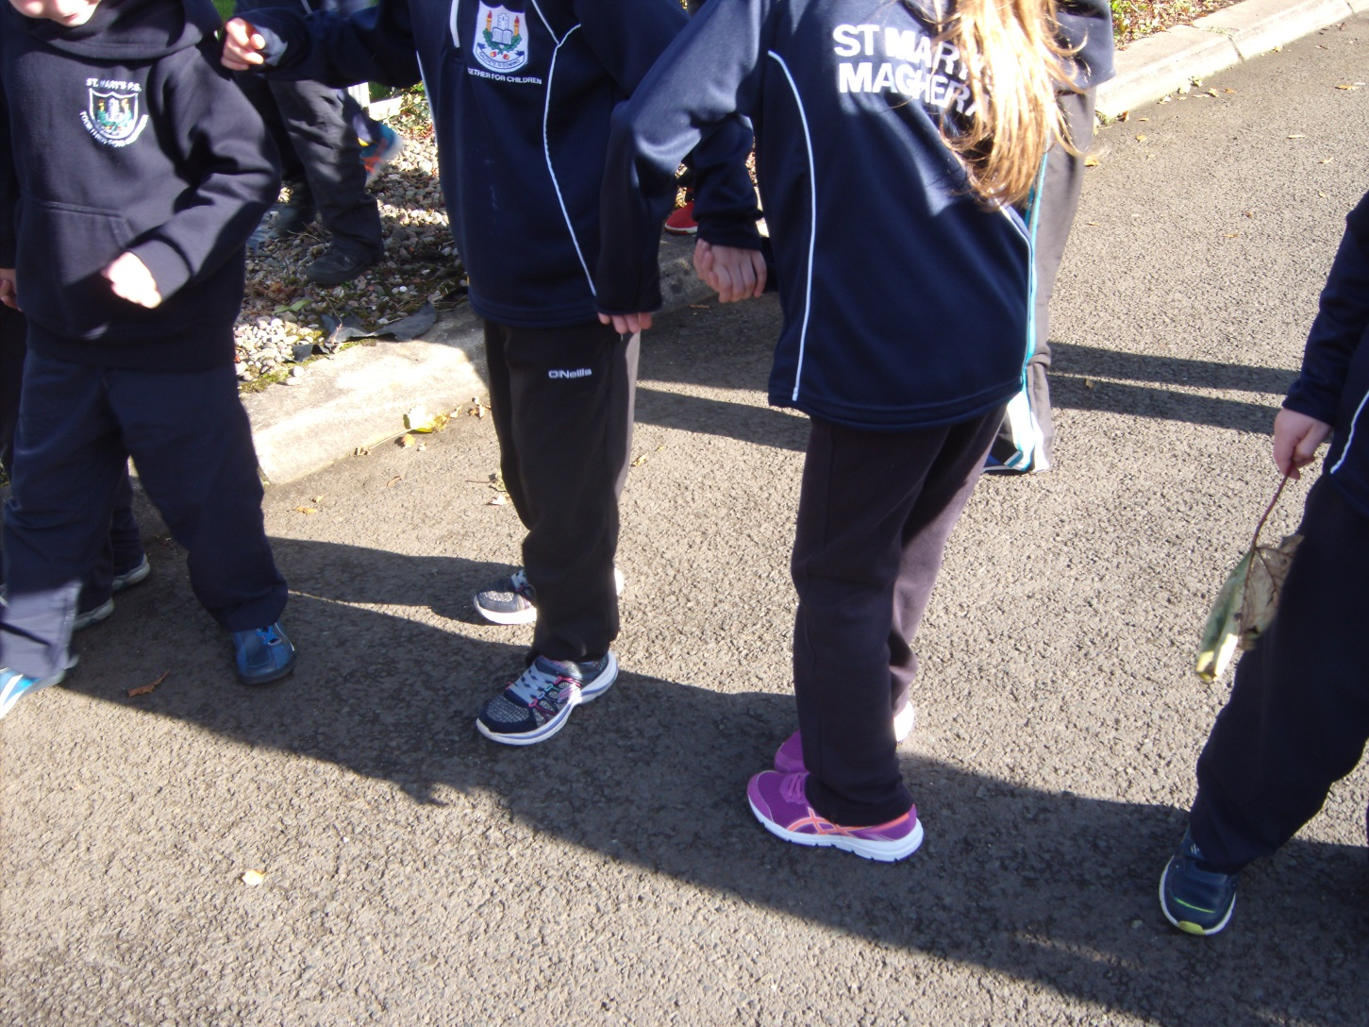
“Hi, you are standing on my shadow.”
Notes:
Hi, your standing on my shadow oouch.

Slide 7
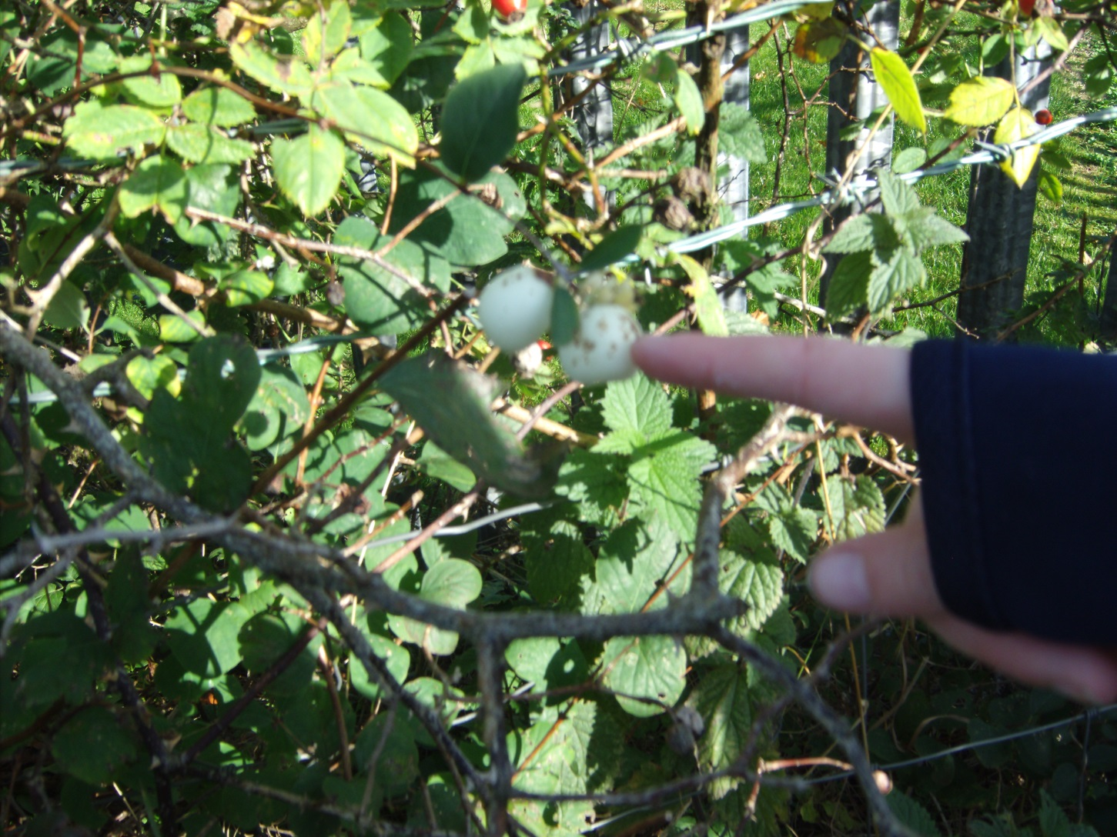
We found rosehips and learnt that they grow when the rose flower has died.

Slide 8
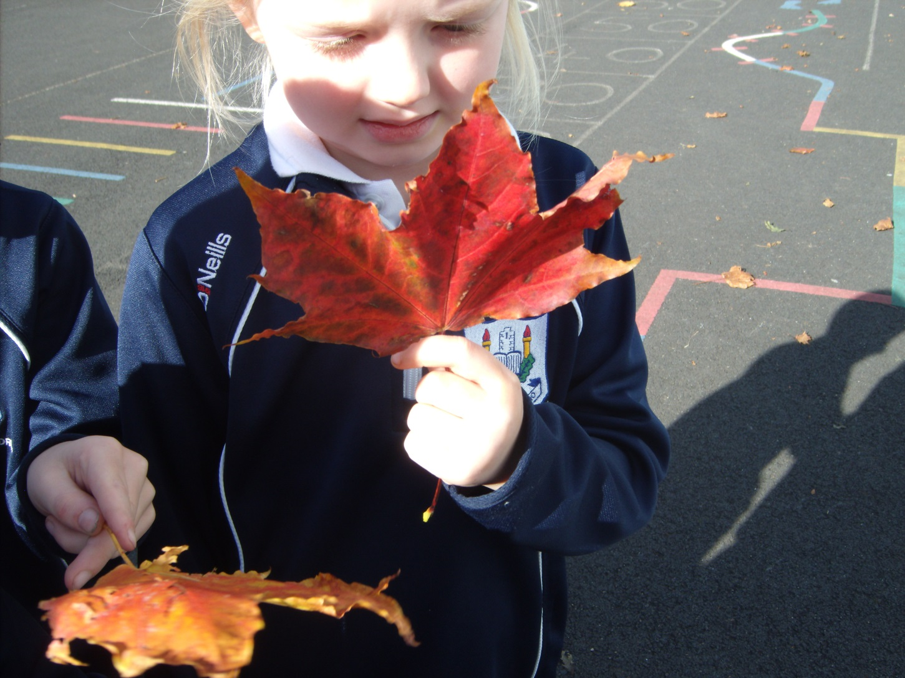
Jodie has found the perfect
Autumn leaf.

Slide 9
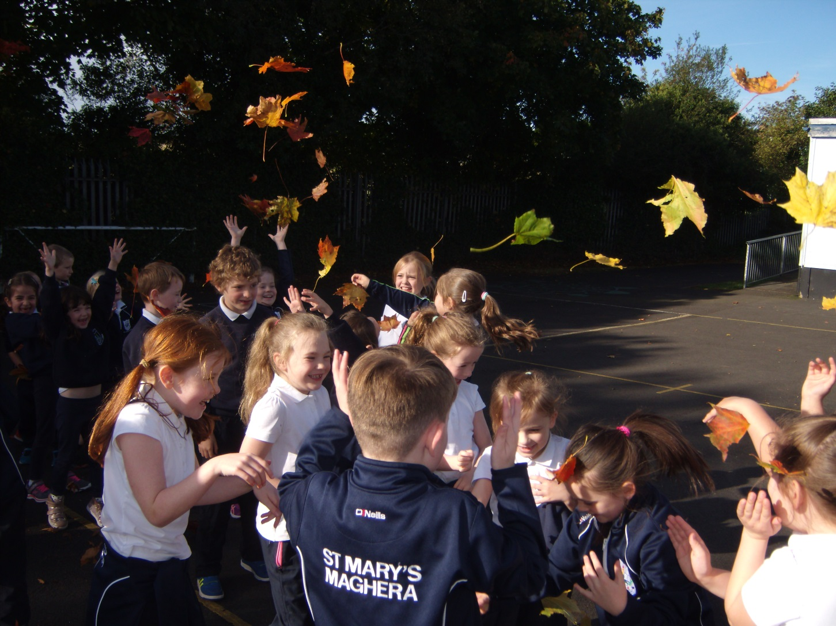
We threw our Autumn leaves into the air and enjoyed them falling on us.

Slide 10
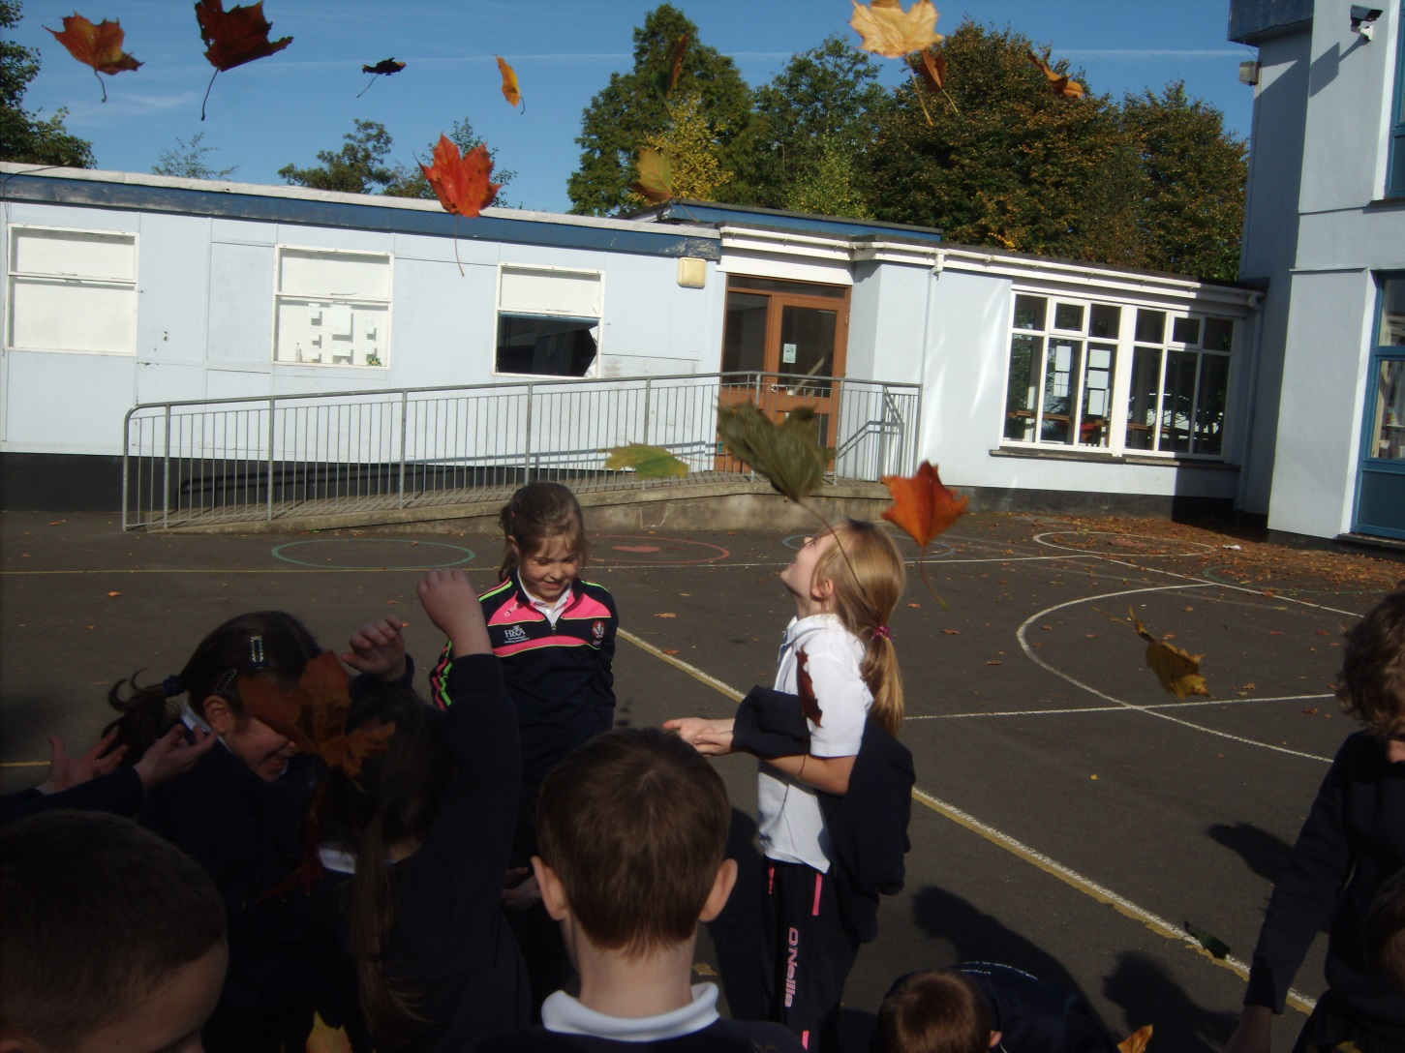
P3/P4 enjoyed their Autumn trail.

